Slide 1
Optimal path tracking of a mobile robot
Constrained Numerical Optimization for Estimation and Control
M.Sc. Automation and Control Engineering
Cataldo Giuseppe
Giacomelli Gianluca
Gottardini Andrea

Slide 2




Who we are
Cataldo Giuseppe
Giacomelli Gianluca
Gottardini Andrea
Cataldo, Giacomelli, Gottardini
Cataldo, Giacomelli, Gottardini

Slide 3
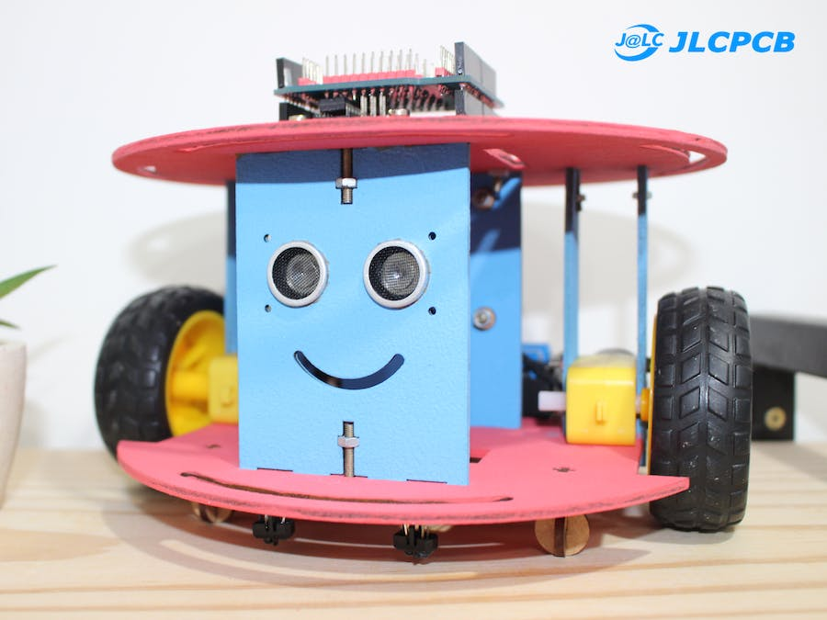
Our problem
Easy to integrate
Increased Flexibility
Increased Safety
Ability to Scale
Cataldo, Giacomelli, Gottardini
Unemployment
rate > 13%

Slide 4

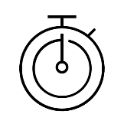



Our goal
MPC formulation
Cost function
Time
Counturing error
Energy consumption
Torque Right Wheel
Torque Left Wheel
States
Position
Yaw
Angular Rotation of wheels
Input
Angular Speed of wheels
Cataldo, Giacomelli, Gottardini

Slide 5
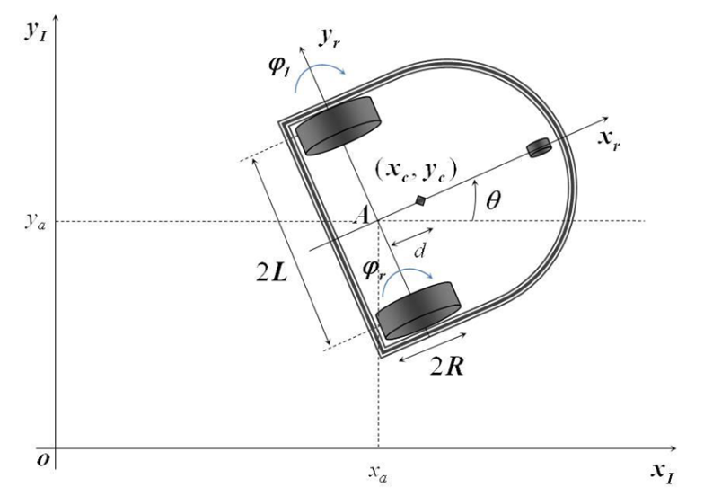

Model variables and parameters
$θ_{c}\left(t\right)$yaw angle
$x_{c}\left(t\right)$ x-coordinate of the center of mass
$Y_{c}(t)$ y-coordinate of the center of mass
$φ_{l}(t)$ angular rotation of the left wheel
$φ_{r}(t)$ angular rotation of the right wheel
$\dot{φ_{l}}(t)$ angular speed of the left wheel
$\dot{φ_{r}}(t)$ angular speed of the right wheel
$r(t)$ distance from a target point
2L width of the mobile robot
R radius of the wheel
I_{c.} moment of inertia of the car
I_{w.} moment of inertia of the wheel
d distance center of mass – rear axle
m_{w} mass of the wheel
m_{c} mass of the car
$\overline{τ_{r}}$ maximum right torque
$\overline{τ_{l}}$ maximum left torque
Variables
Parameters
Cataldo, Giacomelli, Gottardini

Slide 6
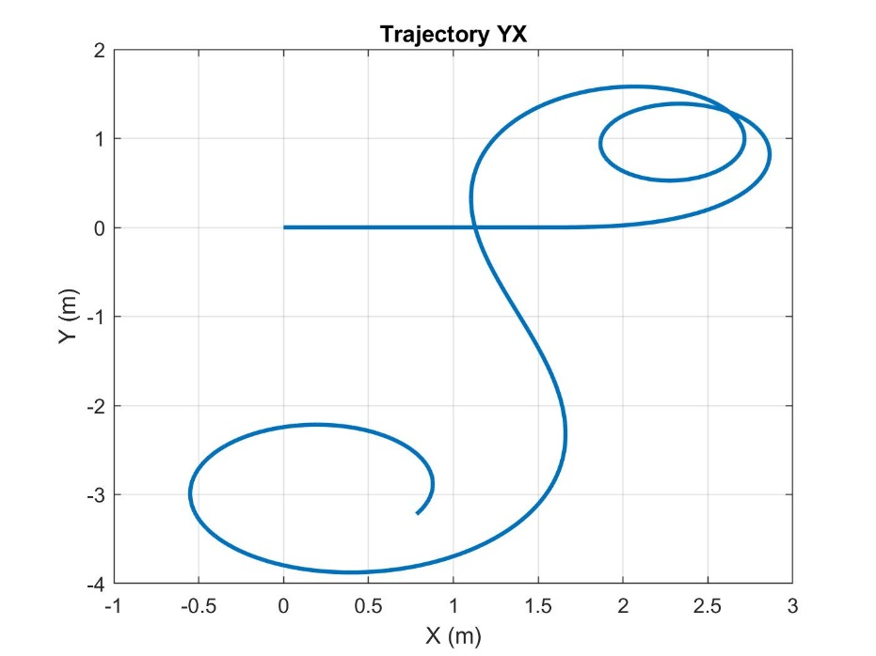
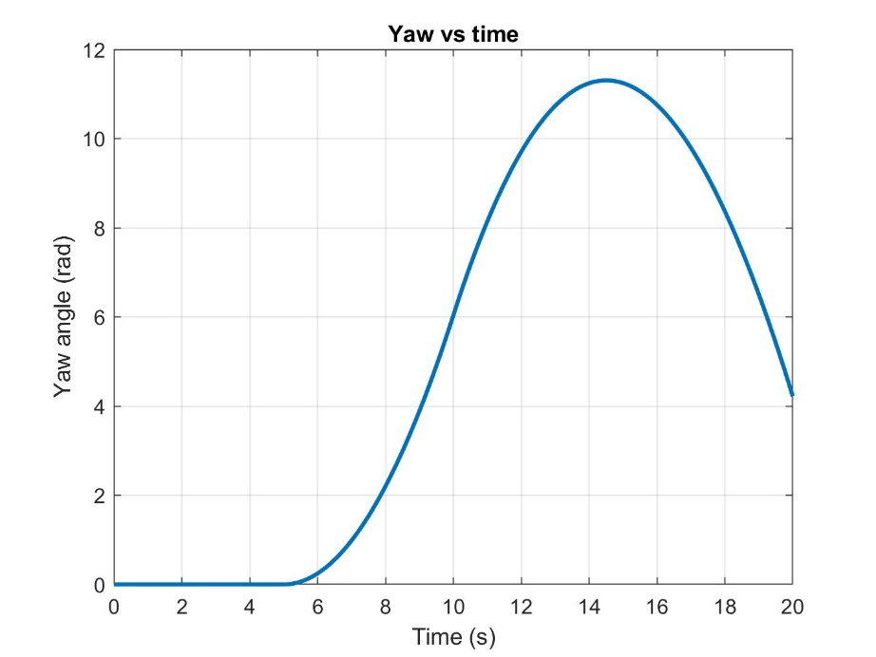
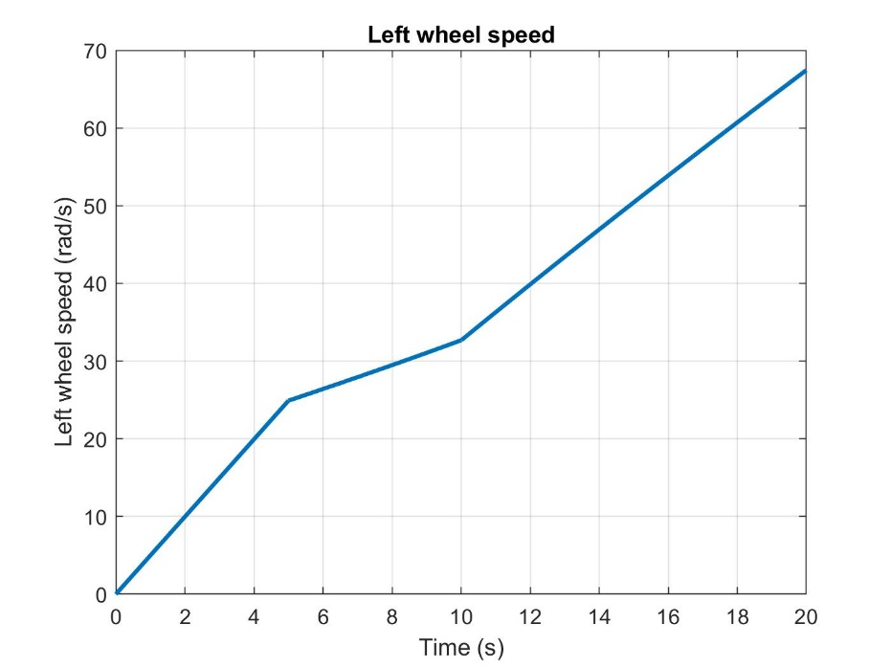
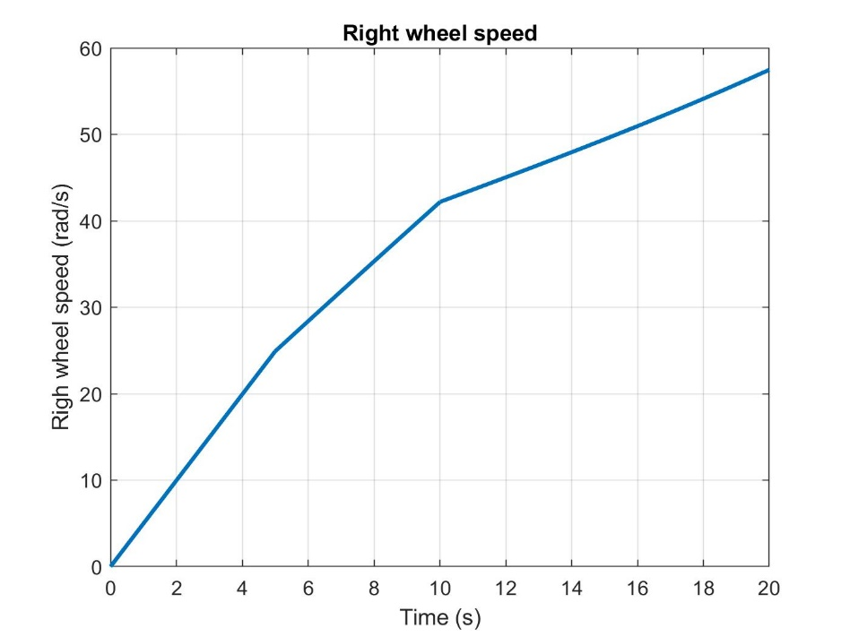
MATLAB Simulation Results
Cataldo, Giacomelli, Gottardini

Slide 7
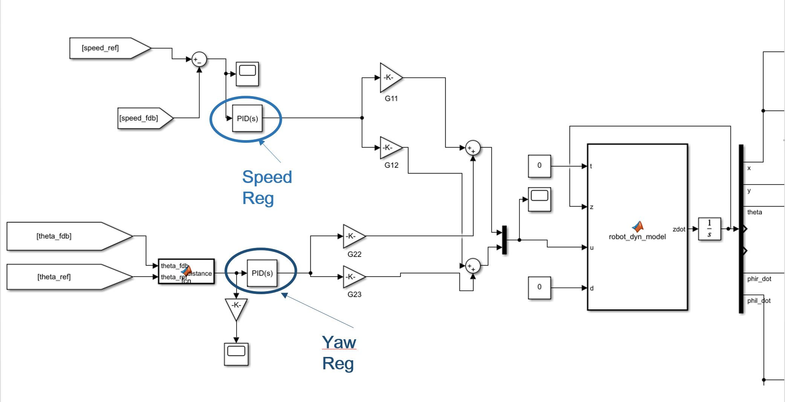


Simulink Model
*
*
*
*
Cataldo, Giacomelli, Gottardini

Slide 8
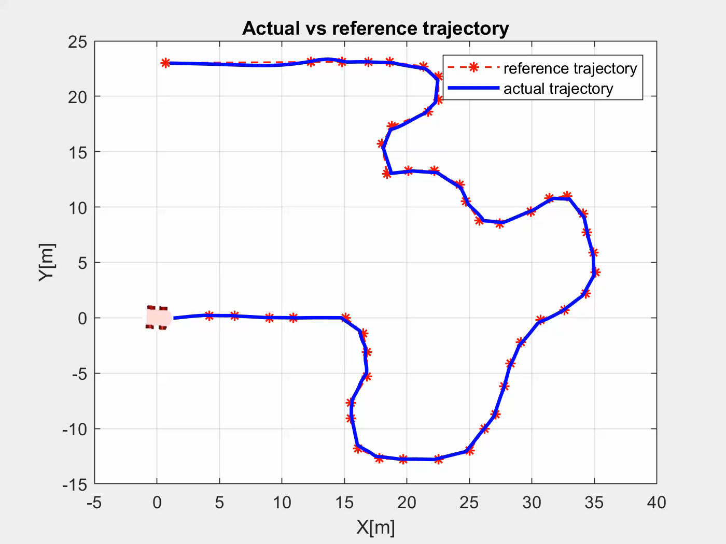
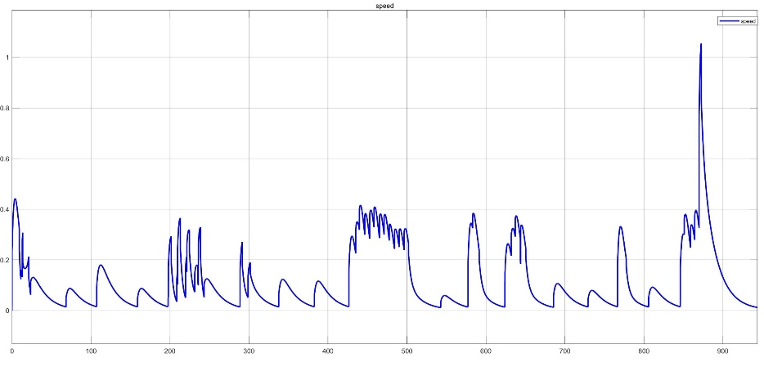

Path Following with PID regulators
Speed Profile
Waste of energy!
Cataldo, Giacomelli, Gottardini

Slide 9
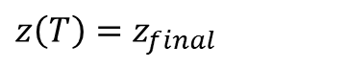
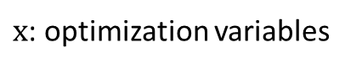



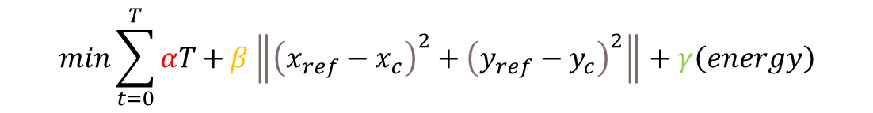
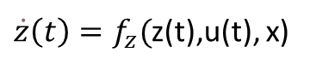
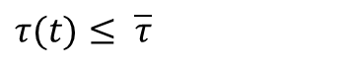
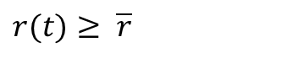

Cost Function and constraints
Time
Contouring error
Energy Consumption
Multi
optmization
problem
$$min\sum_{t=0}^{T}{αT+}β\left\|{\left(x_{ref}−x_{c}\right)}^{2}+{\left(y_{ref}−y_{c}\right)}^{2}\right\|+γ\left(energy\right)$$
$$x$$
$$S.T.$$
$\dot{z}\left(t\right)=f_{z}($z(t),u(t), x)
Model Equations
$$r(t)≥ \overline{r}$$
Distance from a target point
$$τ(t)≤ \overline{τ}$$
Maximum Torques
$$z\left(0\right)=z_{0}$$
Initial State
$$z\left(T\right)=z_{final}$$
Final State
$x$: optimization variables
$$x=\left[\begin{matrix}τ_{r} \\ τ_{l}\end{matrix}\right]$$
Cataldo, Giacomelli, Gottardini

Slide 10
Conclusion
Thank you!!!!

